Slide 1

Time series Forecasting
Machine Learning Assignment_6
Kushum K C

Slide 2
Time Series Forecasting
Time Series
sequence of data points measured over time
Time Series Forecasting
statistical technique that involves predicting future values of a time series based on its historical patterns and trends
Long Short-Term Memory (LSTM) method
commonly used recurrent neural network (RNN) in time series forecasting
considers previous inputs & their corresponding outputs to capture the sequential nature of time series data
highly accurate, computationally intensive and require large amounts of training data to achieve optimal performance
LSTM uses:
series of "memory cells" : to store information over time
"gates“: to control the flow of information in and out of the cells.

Slide 3
Dataset
Data used for assignment 5
1. J-17 well index
2. Comal Spring Discharge
3. San Marcos Spring Discharge
The imputed data (using Kalman filter) has been used

Slide 4
Steps for Time Series Forecasting
Step 1: Read the .csv file into a panda dataframe
Date set as index
Step 2: Normalize the dataset
done to ensure all the variables are on one comparable common scale
Makes the data interpretation process easier
Data transformed using the “MinMaxScaler” from scikit-learn to normalize data at range (0,1)
Step 3: Train Test Split
Make input output sequence using “np.array”
Split to train test (75: 25)
Reshape the input data “np.reshape”

Slide 5
Steps for Time Series Forecasting Conti…
Step 4: Define Model
Number of layers: 2
Sequence length: 10
Epoch size: 5
Batch size: 32
Keras in python
“keras.layers”,
“keras.models”
Step 5: Model Fit
Model is fit for the training dataset avoiding overfitting
“model.fit”
“model.predict”
Step 6: Evaluate Model
Model is evaluated by Observed Vs Forecast plot
RMS error for training and testing data
Fitted model is used for forecasting the test data

Slide 6

Model
Two layered model
one LSTM layer with 50 units and one dense layer with single unit
Input shape for LSTM layer
LSTM Model takes sequential input as sequence length
Modelled for sequence length of 10
LSTM layer processes 10 sequence value to produce single output at one time step
This output is fed to dense layer with single neuron to produce final forecast for the model
Number of Neuron in LSTM Layer
Value is set to 50, i.e., the layer will have 50 memory cells

Slide 7
Model Conti…
Optimizer
updates the parameters (weights and Bias) of a LSTM cell during training of model
minimize the error between the model's predictions and the true value
Adam optimizer
combination of both Adagrad and RMSprop optimizers, useful for dealing with sparse gradients and non-stationary objective functions
Loss Function
used to measure the difference between the predicted output and the actual output (training dataset)
Mean Squared Error (MSE) loss (commonly used)
calculated as the average of the squared differences between the predicted output and the actual output

Slide 8
Model Evaluation
1. Plot of Observed Vs Forecasted values
Data frames (observed and forecast)
train dataset and forecast from training dataset
test dataset and forecast from test dataset
Plot for train and test dataset separately
Observed Vs forecasted plot
plot with points concentrated towards X=Y line represents a good fit model
2. RMSE (Root Mean Square Error)
Common and useful evaluation metric for evaluating the accuracy of the model
lower values indicate better performance
comparing the training and testing RMSE helps get idea of how well model generalizes to new data
if the training RMSE is much lower than the testing RMSE - sign of overfitting

Slide 9
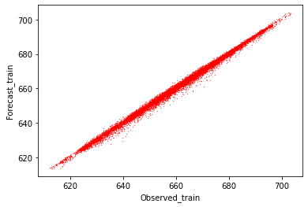
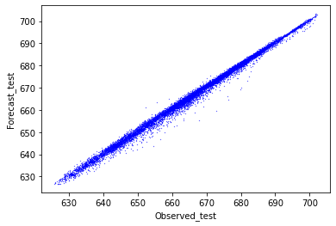

FORECASTING RESULTS: J-17 WELL
Observed Vs Predicted Training dataset of J-17 well
Observed Vs Predicted Testing dataset of J-17 well
RMSE score for Train and Test dataset

Slide 10
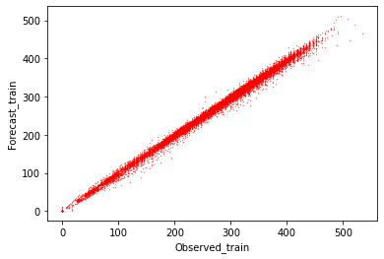
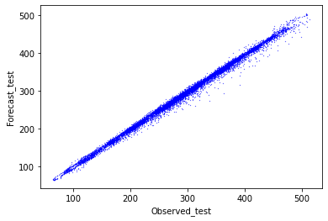

FORECASTING RESULTS: COMAL SPRING
Observed Vs Predicted Training dataset of Comal Spring discharge
Observed Vs Predicted Testing dataset of Comal Spring discharge
RMSE score for Train and Test dataset

Slide 11
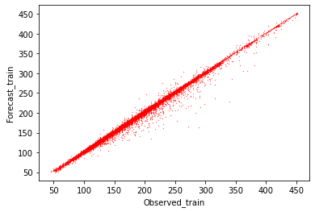
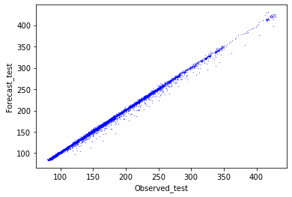

FORECASTING RESULTS: SAN MARCOS SPRING
Observed Vs Predicted Training dataset of San Marcos Spring Discharge
Observed Vs Predicted Testing dataset of San Marcos Spring Discharge
RMSE score for Train and Test dataset

Slide 12
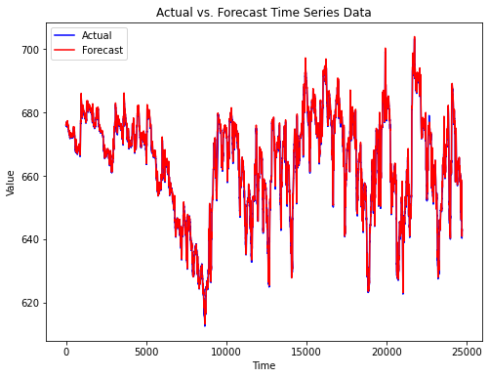
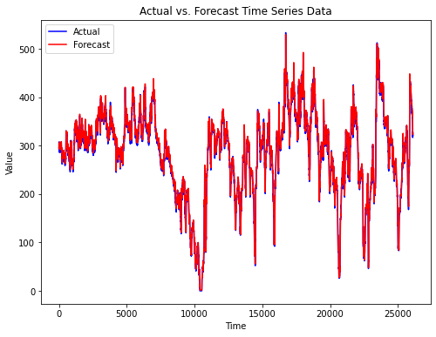
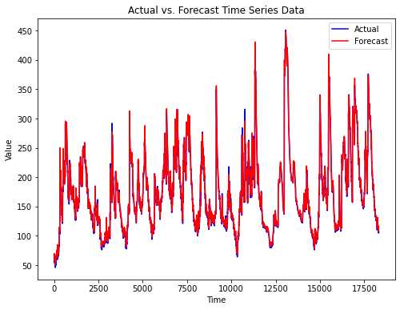
Observed and Forecast Time Series Overlay
J-17 Well index water level
Comal Spring Discharge
San Marcos Spring Discharge

Slide 13
Conclusion
Forecasting in time series dataset using ANN (LSTM) model
Normalization needed
after model is fit, inverse transformation done before analyzing/evaluating the results
Train-Test split (different from normal regression problem)
Input and output sequence
Layers of the model consider carefully
Epoch
Each epoch improves the model's performance by iteratively adjusting the parameters to reduce the training loss
Increased number of epochs makes the model better at capturing the patterns and dependencies in the time series data and can make more accurate predictions on unseen data
but number of epoch should be optimized to reduce chance of overfitting the model

Slide 14

Refrence
Data downloaded from
https://www.edwardsaquifer.org/science-maps/aquifer-data/historical-data/

Slide 15

Thank You

